Slide 1
USP 800
& Hazardous Medication
Melissa Comstock, B.Sc. Pharmacy, R.Ph.
Pharmacy Manager-Inpatient Operations

Slide 2
USP 800 & Hazardous Medications
Objectives:
Locate Stormont Vail’s Hazardous Drug List
Discuss Stormont Vail’s policies related to the handling of HDs.
Describe proper PPE for handling hazardous drugs
Describe hazardous spill management in the Pharmacy
Describe response to known or suspected HD exposure
Notes:
.

Slide 3
USP 800 & Hazardous Medications
USP 800 is the foundational document that guides a health system’s handling, preparation and administration of compounded hazardous medications.

Slide 4
USP 800 & Hazardous Medications
The NIOSH (National Institute for Occupational Safety and Health) list of Antineoplastic and Other Hazardous Drugs in Healthcare Settings, 2016 is the foundational document that guides a health system’s handling, administration and disposal of hazardous medications.
Notes:
The NIOSH list is not a risk assessment. It identifies hazardous drugs only. Health care sites, like Stormont, must evaluate their own practices every 12 months.

Slide 5
USP 800 & Hazardous Medications
How does USP 800 impact you?

Slide 6
USP 800 & Hazardous Medications
All personnel that handle hazardous drugs (HDs) as part of their job duties must have documented training and competency in the following:
• Overview of entity's list of HDs and their risks (system hazardous drug list)
• Review of the entity's SOPs related to handling of HDs
• Proper use of PPE, equipment and devices
• Response to known or suspected HD exposure
• Spill management
• Proper disposal of HDs and trace-contaminated materials.

Slide 7
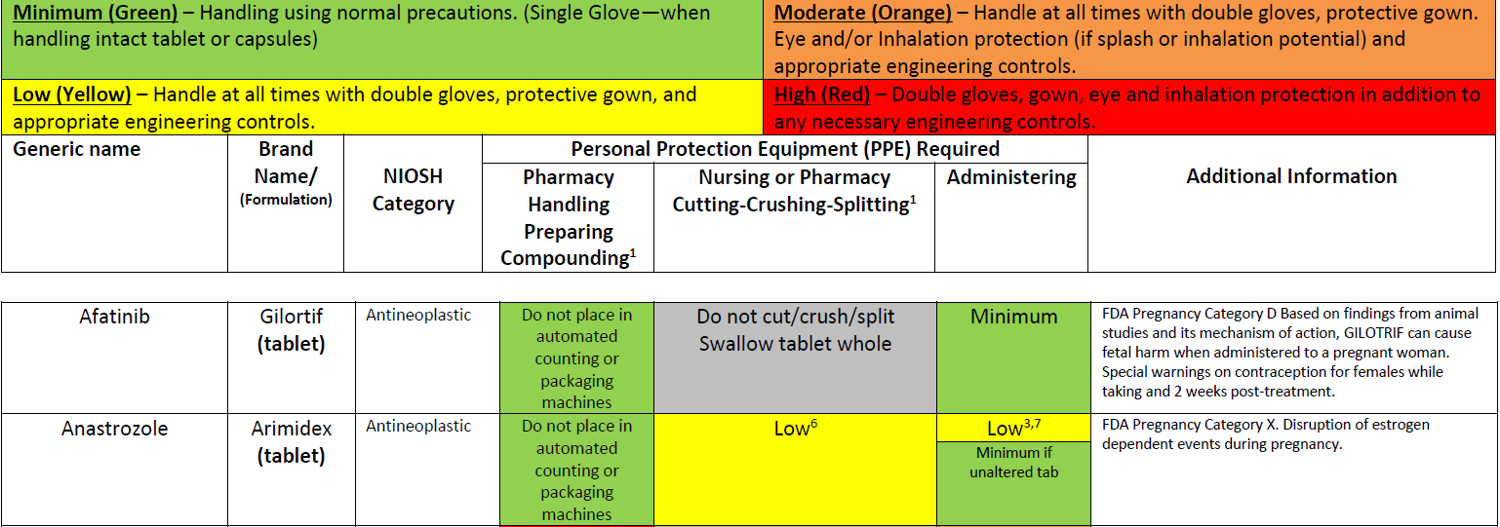
USP 800 & Hazardous Medications
Hazardous Medication List
NIOSH list is from 2016. SVH hazardous medication list has been updated to remove non-formulary drugs and revise PPE/Handling instructions.
Color coded PPE recommendation
and risk assessment.
Color coded administration instructions

Slide 8
USP 800 & Hazardous Medications
Hazardous Medication List is on Document Central under Division & Department Pages->Pharmacy->Pharmacy documents->Hazardous Medication List-Hospital

Slide 9
USP 800 & Hazardous Medications
Waste disposal guide is on Document Central under Division & Department Pages->Pharmacy->Pharmacy documents->Medication Waste Stream Disposal.
Note that not all hazardous medications are hazardous waste and not all hazardous waste is hazardous to humans.

Slide 10
USP 800 & Hazardous Medications
Waste Stream Disposal Reference has been revised to current standards

Slide 11
SVH Policies related to Hazardous Drug Handling
Please review the following policies in Document Central
Compounding-Deactivating, Decontaminating, Cleaning and Disinfecting Hazardous Drug Areas
Compounding-Hazardous Compounded Sterile Products
Compounding-Hazardous Drug Dispensing, Administration, and Disposal

Slide 12
Hazardous Drug PPE
The Garbing and hand hygiene for preparing sterile hazardous compounds is the same as
for non-hazardous compounding with two exceptions:
Don two pairs of shoe covers
Don two pairs of chemotherapy (nitrile) gloves

Slide 13
Hazardous Drug PPE
Please review the standard work:
Compounding-Best Practice Garbing and Hand Hygiene for Hazardous Sterile Compounding

Slide 14
Hazardous Spill Management
Spill kits contain all of the materials and PPE needed to clean HD spills.
Spill kits and signs restricting access to potential spill areas must be accessible in
all areas in which HDs are routinely handled. In the event that a spill exceeds a volume
of 1.5 Liters of liquid or exceeds the capacity of the spill kit, activate
the Hazardous Spill Response Procedure.

Slide 15
Response to Hazardous Drug Exposure
Report any accidental exposure resulting from a spill, needle stick,
or other accident to the Pharmacy Operations Manager
or Director of Inpatient & Infusion Pharmacy Services.
If employee is injured and needs medical attention, contact Employee Health (785-354-5928).

Slide 16
Response to Hazardous Drug Exposure
In the event of accidental skin contact:
1. Immediately remove gloves and/or contaminated clothing.
2. Cleanse the affected skin immediately with soap and warm running water.
3. Refer to product Material Safety Data Sheet and perform decontamination as directed.
4. Notify Supervisor or Manager and call Employee Health for guidance.

Slide 17
Response to Hazardous Drug Exposure
In the event of accidental eye contact:
1. If you need assistance flushing eyes, CALL FOR HELP.
2. Remove gloves and other contaminated PPE.
3. Proceed to the eyewash station and flush affected eye(s) with copious amounts
of water or isotonic eyewash for at least 15 (fifteen) minutes.
4. Hold eye(s) open with thumb and finger and look directly into the water stream
– move eye(s) around to wash all around.
5. Do NOT rub eye(s).
6. Do NOT use tap water as pressure damage may occur.
7. Notify Supervisor or Manager and call Employee Health for guidance.

Slide 18
Response to Hazardous Drug Exposure
Please review the policy: Management of Hazardous Drug Spills in the Pharmacy Department

Slide 19
Please proceed to the post-test

